Slide 1
National Institute of Technology, Tiruchirappalli
Department of Mechanical Engineering
MEPE22: MEMS Devices–Design and Fabrication
Assignment No. 1
Project Title: AEROSENSE-A Silicon-Carbide Schottky Diode Gas Sensor for Aerospace Applications
Group No. 5 (ME-A)
Aditya Pratap Singh-111122005
Ankur Das-111122013
Sunil Kumawat-111122127

Slide 2

Introduction to Field of Application: Aerospace
In aerospace applications, a variety of chemical sensing technologies are essential for monitoring conditions in space vehicles and during aircraft or spacecraft operations. These technologies aim to produce microsensor platforms that can be customized to measure different species, supported by the development of miniaturized hardware and software systems. The goal is to create Smart Sensor Systems compact enough to be placed strategically within a vehicle, offering functionalities such as microprocessor control, signal conditioning, and communication. A core capability has been developed to measure various chemical species relevant to aerospace, including CO, CO₂, H₂, NO_{x}, C_{x}H_{y}, etc. Integration with hardware and software, considering factors like size, weight, power consumption, and environmental durability, is crucial for implementing these sensor systems in flight applications. Extensive testing of the complete sensor systems in relevant environments ensures their reliability and longevity in aerospace operations.

Slide 3
Gas Sensors for Aerospace Applications
Fuel Leak Detection
Air Quality Monitoring
Engine Emissions Monitoring
To detect fuel vapors in aircraft fuel systems, helping identify leaks and prevent potential fire hazards. Early detection of fuel leaks is critical for ensuring flight safety and minimizing environmental impact.
To monitor the air quality inside aircraft cabins, detecting pollutants, such as volatile organic compounds, CO, etc. Maintaining optimal air quality is essential for passenger comfort and health during flights
Gas sensors are employed to monitor engine exhaust emissions, including CO₂, NO_{x} and C_{x}H_{y}, Monitoring engine emissions ensures compliance with environmental regulations and helps optimize engine performance and fuel efficiency.
Fire Detection
Life Support Systems
To detect the presence of combustion gases such as CO, CO₂ and H₂. Early detection of fire or overheating components is crucial for preventing catastrophic events.
In spacecrafts, gas sensors are integrated into life support systems to monitor and control the composition of the spacecraft's atmosphere to detect levels of O₂, CO₂, and other gases to ensuring safe and breathable environment for crew members

Slide 4

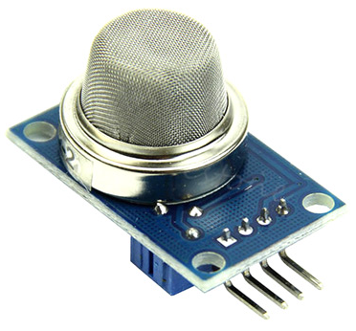
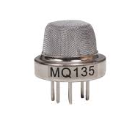
Gas Sensors : Introduction
A gas sensor is a device which detects the presence or concentration of gases in the atmosphere. Based on the concentration of the gas the sensor produces a corresponding potential difference by changing the resistance of the material inside the sensor, which can be measured as output voltage. Based on this voltage value the type and concentration of the gas can be estimated.
Example of a commonly used gas sensor: MQ 6 (Leakage Detection Gas Sensor)
Example of a commonly used gas sensor: MQ 135 (Air Quality Gas Sensor)

Slide 5
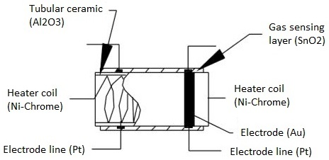
Gas Sensors : Construction
Gas Sensing Layer: It is the main component in the sensor which can be used to sense the variation in the concentration of the gases and generate the change in electrical resistance. The gas sensing layer is basically a chemi-resistor which changes its resistance value based on the concentration of particular gas in the environment. Here the sensing element is made up of a tin dioxide (SnO₂) which is, in general, has excess electrons (donor element). So whenever toxic gases are being detected the resistance of the element changes and the current flown through it varies which represents the change in concentration of the gases.
Heater Coil: The purpose of the heater coil is to burn-in the sensing element so that the sensitivity and efficiency of the sensing element increases. It is made of Nickel-Chromium which has a high melting point so that it can stay heated up without getting melted.
Electrode Line: As the sensing element produces a very small current when the gas is detected it is more important to maintain the efficiency of carrying those small currents. So Platinum wires come into play where it helps in moving the electrons efficiently.

Slide 6
Gas Sensors : Construction
Electrode: It is a junction where the output of the sensing layer is connected to the Electrode line. So that the output current can flow to the required terminal. An electrode here is made of Gold which is a very good conductor.
Tubular Ceramic: In between the Heater coil and Gas sensing layer, the tubular ceramic exists which is made of Aluminum oxide (Al₂O₃). As it has high melting point, it helps in maintaining the burn-in (preheating) of the sensing layer which gives the high sensitivity for the sensing layer to get efficient output current.
Mesh over the Sensing Element: In order to protect the sensing elements and the setup, a metal mesh is used over it, which is also used to avoid/hold the dust particles entering into the mesh and prevent damaging the gas sensing layer from corrosive particles.

Slide 7
Gas Sensors : Working Principle
The ability of a gas sensor to detect gases depends on the chemi-resistor to conduct current. The most commonly used chemi-resistor is tin dioxide (SnO₂) which is an n-type semiconductor that has free electrons (also called as donor). Normally the atmosphere will contain more oxygen than combustible gases. The oxygen particles attract the free electrons present in SnO₂ which pushes them to the surface of the SnO₂. As there are no free electrons available output current will be zero.
When the sensor is placed in the toxic or combustible gases environment, this reducing gas (orange color) reacts with the adsorbed oxygen particles and breaks the chemical bond between oxygen and free electrons thus releasing the free electrons. As the free electrons are back to its initial position they can now conduct current, this conduction will be proportional the amount of free electrons available in SnO₂, if the gas is highly toxic more free electrons will be available.
In the above illustration, the oxygen molecules (blue color) attracting the free electrons (black color) inside the SnO2 and preventing it from having free electrons to conduct current.

Slide 8
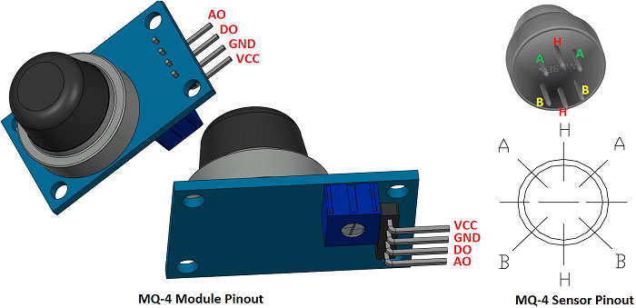
Gas Sensors : Architecture
A basic gas sensor has 6 terminals in which 4 terminals (A, A, B, B) acts input or output and the remaining 2 terminals (H, H) are for heating the coil. Of these 4 terminals, 2 terminals from each side can be used as either input or output and vice versa.
These sensors are normally available as modules (shown right), these modules consist of the gas sensor and a comparator IC. Now let’s see the pin description of the gas sensor module which we will generally use with an Arduino. The gas sensor module basically consists of 4 terminals:
VCC : This terminal is used for connecting the positive supply voltage
GND : This terminal is used for connecting the ground or reference voltage
Digital Output : This pin gives an output either in logical high or logical low (0 or 1) that means it displays the presence of any toxic or combustible gases near the sensor.
Analog Output : This pin gives an output continuous in voltage which varies based on the concentration of gas that is applied to the gas sensor.
MQ 4 Sensor Pinout
MQ 4 Module Pinout

Slide 9
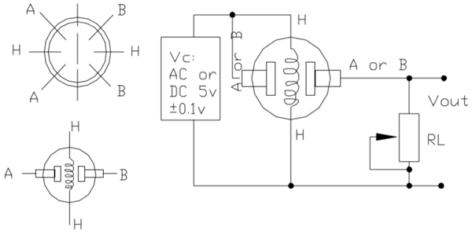
Gas Sensors : Circuit Diagram
Here, A and B are the input and output terminals (these are reversible - means any of the paired terminals can be used as input or output) and H is the Heater coil terminal. The purpose of the variable resistor is to adjust the output voltage and to maintain high sensitivity.
If no input voltage is applied to the heater coil, then the output current will be very less. When sufficient voltage is applied to the input terminal and heater coil, the sensing layer wakes up and is ready to sense any combustible gases nearby it. Initially let’s assume that there is no toxic gas near the sensor, so the resistance of the layer doesn’t change and the output current and voltage are also unchanged and are negligible. Now let’s assume that there is some toxic gas nearby. As the heater coil is pre-heated it is now easy to detect any combustible gases. When the sensing layer interacts with the gases, the resistance of the material varies and the current flowing through the circuit also varies. This change in variation can be then observed at the load resistance.

Slide 10
Benefits of Using Gas Sensors For Aerospace Applications
Safety Enhancement
Gas sensors can detect hazardous gases such as carbon monoxide, methane, and hydrogen in aircraft cabins or fuel systems. Early detection allows for prompt action, mitigating potential safety risks to passengers and crew.
Maintenance Optimization
Environmental Monitoring
To monitor the air quality inside aircraft cabins, detecting pollutants, such as volatile organic compounds, CO, etc. Maintaining optimal air quality is essential for passenger comfort and health during flights
Gas sensors aid in monitoring air quality and detecting pollutants emitted from aircraft engines, contributing to environmental sustainability efforts.
Fire Prevention
Gas sensors play a crucial role in fire detection and prevention by monitoring for combustible gases or smoke in critical areas of the aircraft.
Compliance Assurance
Fuel Efficiency
Gas sensors can detect leaks in fuel systems, helping to conserve fuel and reduce operational costs.
Gas sensors ensure compliance with regulatory standards and aviation safety regulations by monitoring and controlling gas emissions within permissible limits.

Slide 11
Limitations of Using Gas Sensors For Aerospace Applications
Extreme Conditions
Cross-Sensitivity
External Interference
Aerospace environments are characterized by extreme temperatures, high vibration levels, and varying atmospheric pressures, which can impact the performance and reliability of gas sensors. Ensuring sensor durability and stability under these conditions is crucial
Gas sensors may exhibit cross-sensitivity to other gases present in the environment, leading to false readings or inaccuracies. Discriminating between different gases becomes more challenging in complex aerospace environments where multiple gases may be present simultaneously
Electrical noise and electromagnetic interference from other onboard systems can interfere with gas sensor operation, leading to erroneous readings or signal degradation. Shielding and filtering techniques may be required to mitigate these effects
Calibration and Drift
Response Time
Gas sensors require periodic calibration to maintain accuracy and reliability. However, calibration procedures can be challenging to perform in aerospace settings, especially during flight operations.
The response time of gas sensors, particularly for detecting low concentrations of gases, can be critical in aerospace applications. Delays in gas detection and response could impact safety and mission outcomes

